Slide 1
自我介紹

Slide 2
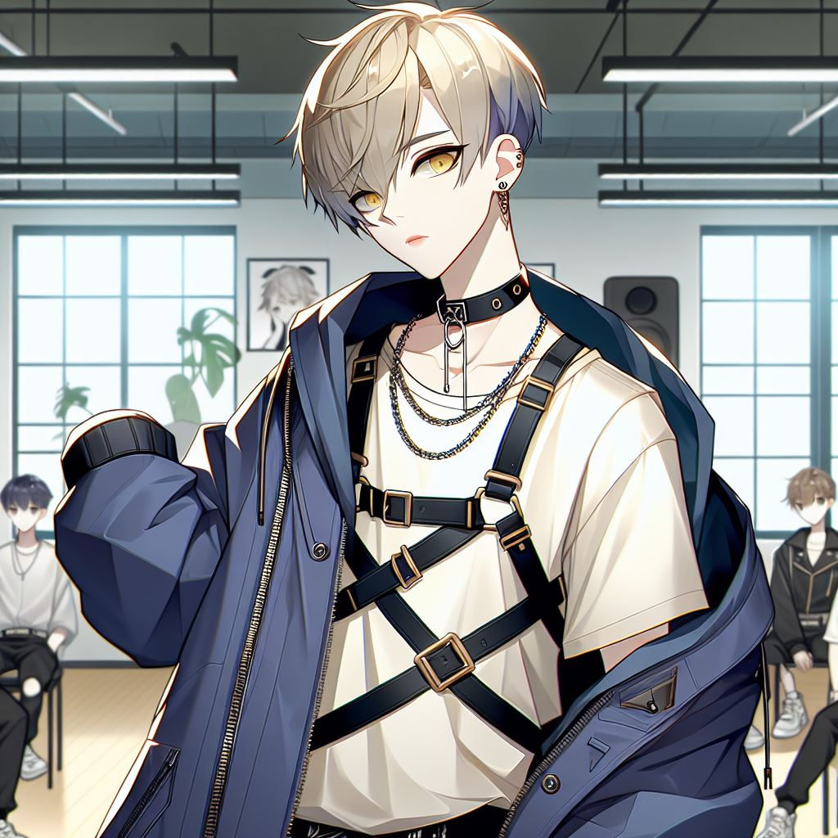
1. 目標
Notes:
主角明是一位藝術高中主修現代舞的學生，皮膚白皙，擁有金色和藍色混合的短髮，黃眼睛。角色穿著未來感的街頭風衣服，包括深藍色的寬鬆外套，搭配一件白襯衫和胸前的束帶。脖子上戴著鍊條項圈。背景是在舞蹈教室裡，旁邊有幾個同學。請幫我根據這段落創建動漫風格的圖片。
Anime-style illustration of a high school student named Ming, who is an art high school student majoring in modern dance. He has fair skin, short hair mixed with blond and blue, and yellow eyes. He is dressed in futuristic streetwear, including an oversized dark blue jacket, a white shirt, and a harness across his chest. He wears a chain choker around his neck. The background is a dance studio with a few classmates nearby, capturing a modern and stylish atmosphere. Ming is striking a modern dance pose.

Slide 3
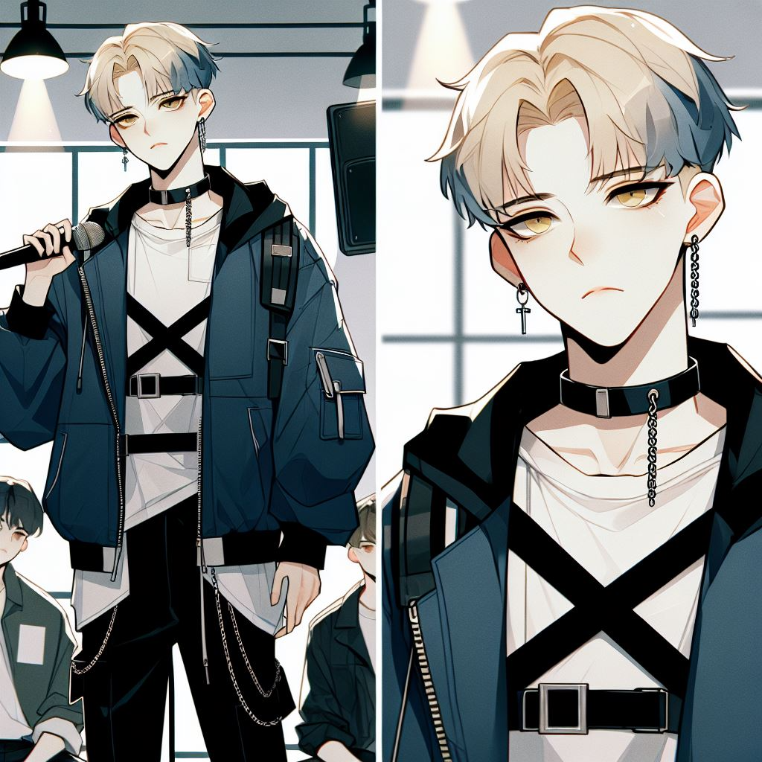
2. 阻礙
Notes:
Anime-style illustration of a high school student named Ming, who is an art high school student majoring in modern dance. He has fair skin, short hair mixed with blond and blue, and yellow eyes. He is dressed in futuristic streetwear, including an oversized dark blue jacket, a white shirt, and a harness across his chest. He wears a chain choker around his neck. The background is a dance studio with a few classmates nearby, capturing a modern and stylish atmosphere. Ming is striking a modern dance pose and holding a microphone with a troubled expression on his face.

Slide 4
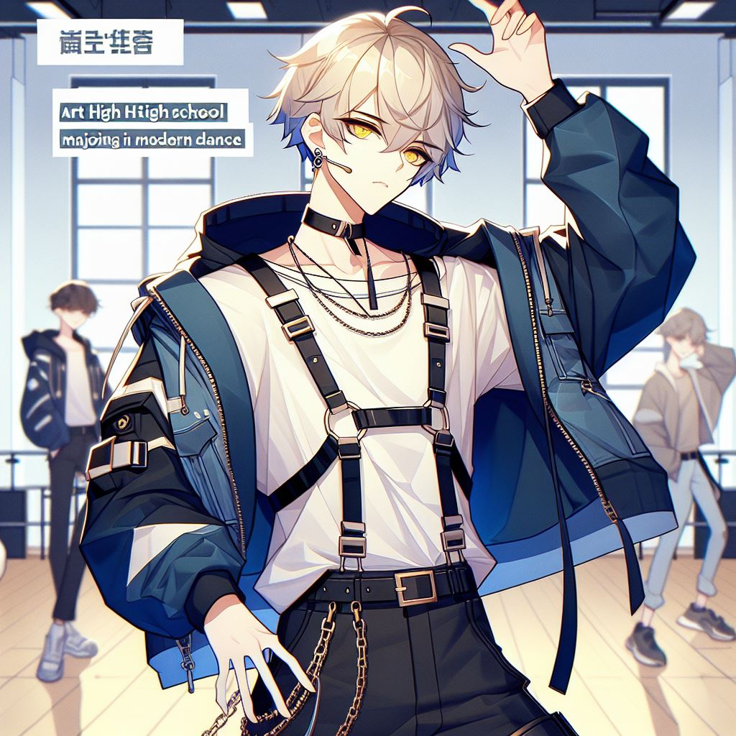
3. 努力
Notes:
Anime-style illustration of a high school student named Ming, who is an art high school student majoring in modern dance. He has fair skin, short hair mixed with blond and blue, and yellow eyes. He is dressed in futuristic streetwear, including an oversized dark blue jacket, a white shirt, and a harness across his chest. He wears a chain choker around his neck. The background is a dance studio with a few classmates nearby, capturing a modern and stylish atmosphere. Ming is striking a modern dance pose and holding a microphone.

Slide 5
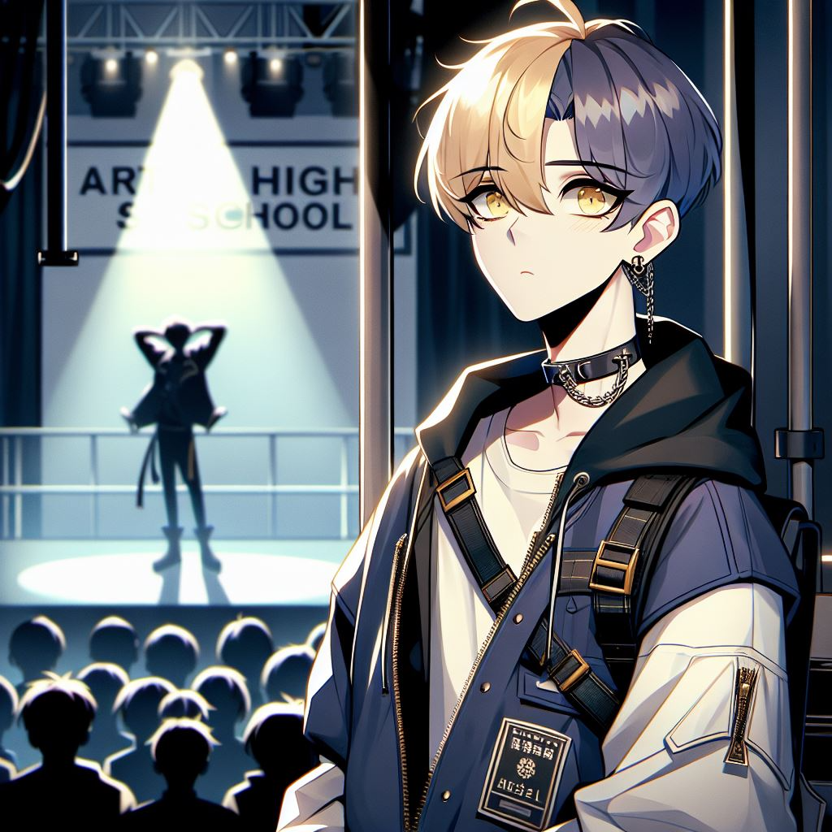
4. 結果
Notes:
Anime-style illustration of a high school student named Ming, an art high school student majoring in modern dance. He has fair skin, short hair mixed with blond and blue, and yellow eyes, with an envious expression as he watches his idol performing on stage. Ming stands backstage, dressed in futuristic streetwear with an oversized dark blue jacket, a white shirt, and a harness across his chest. He wears a chain choker around his neck. The scene captures the dimly lit backstage area, with Ming's idol performing on the brightly lit stage in the background, evoking a sense of admiration and longing.

Slide 6
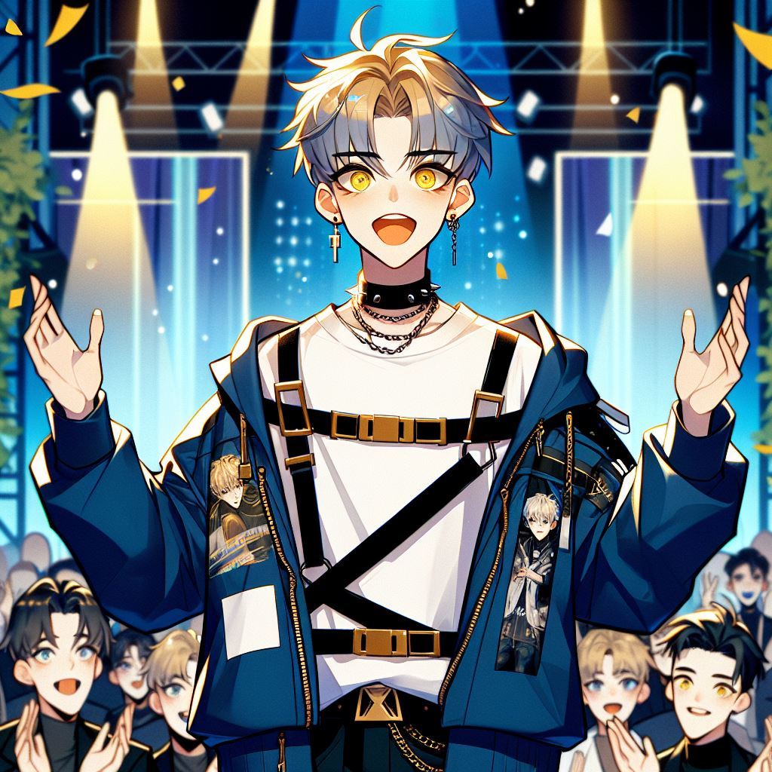
5. 意外
Notes:
Anime-style illustration of a high school student named Ming, an art high school student majoring in modern dance. He has fair skin, short hair mixed with blond and blue, and yellow eyes, with an expression of excitement and surprise as he realizes he has won an award. Ming is on stage at an award ceremony, wearing futuristic streetwear—a dark blue oversized jacket, a white shirt, and a harness across his chest. A chain choker is around his neck. The background shows a decorated stage with lights, confetti, and an audience applauding, capturing the thrilling moment of victory.

Slide 7
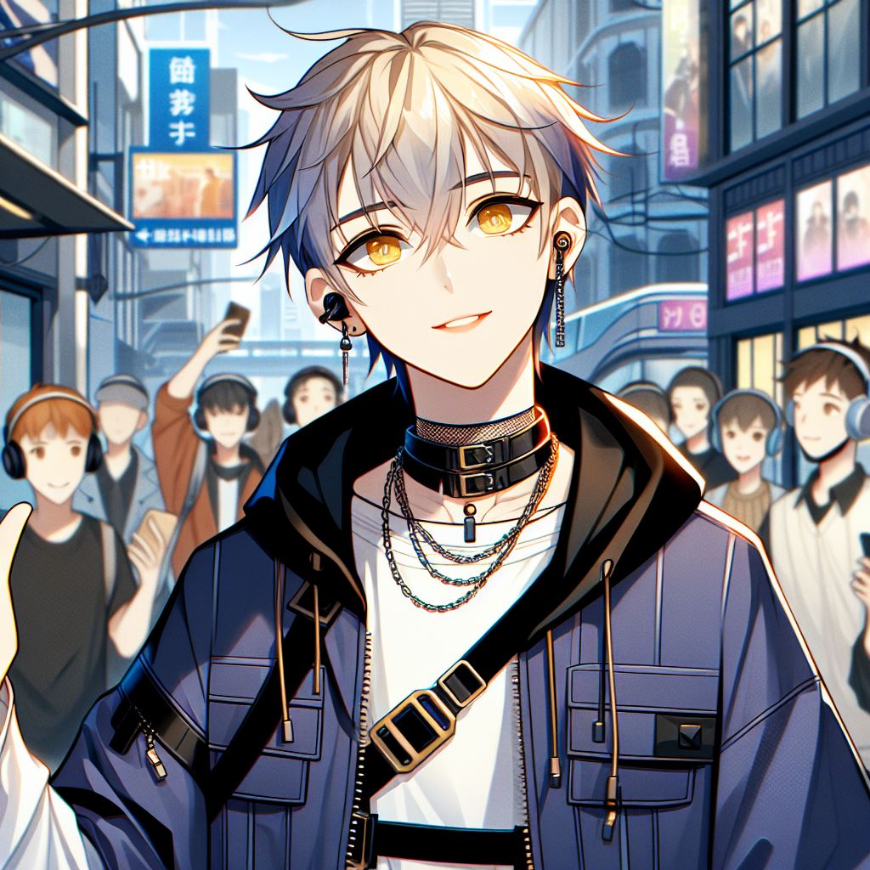
6. 轉彎
Notes:
Anime-style illustration of a high school student named Ming, an art high school student majoring in modern dance. He has fair skin, short blond and blue hair, and yellow eyes, with a proud and happy expression as he notices people on the street listening to his new song. Ming is dressed in futuristic streetwear—a dark blue oversized jacket, a white shirt, and a chest harness, with a chain choker around his neck. The background shows a busy urban street with pedestrians wearing headphones or looking at their phones, captivated by Ming's music playing. The scene captures a modern and vibrant city atmosphere filled with excitement.

Slide 8
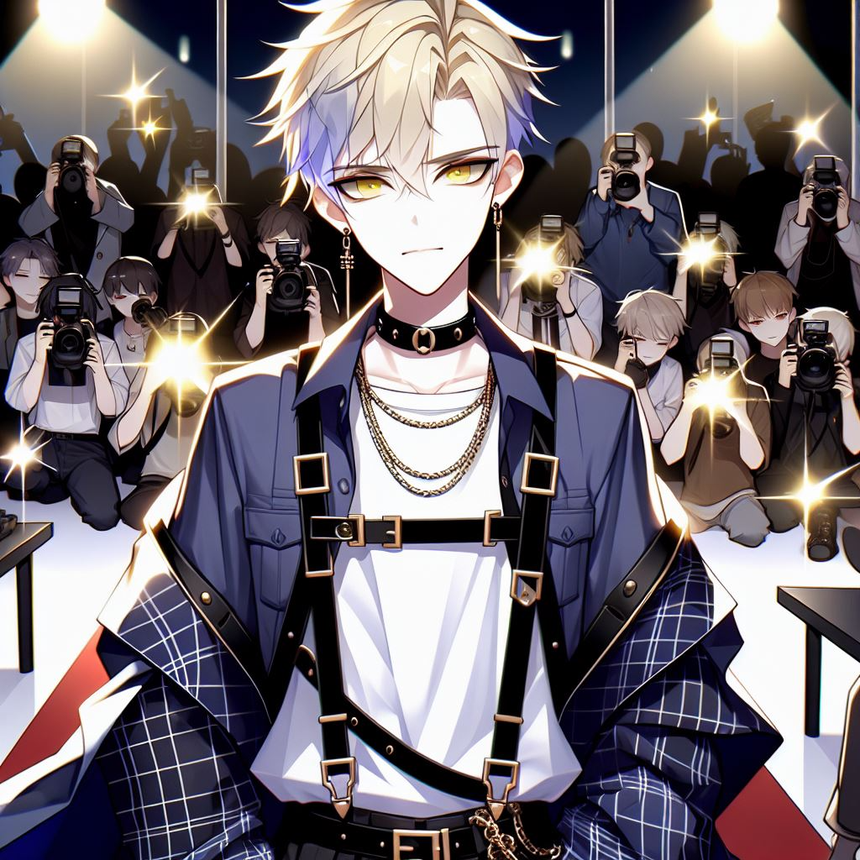
7. 結局
Notes:
Anime-style illustration of Ming, who has become a world-class superstar. He has fair skin, short blond and blue hair, and yellow eyes, exuding confidence and charisma. Ming is dressed in stylish, futuristic streetwear—an oversized dark blue jacket, a white shirt, a harness across his chest, and a chain choker around his neck. He stands on a grand stage or red carpet, surrounded by countless cameras and flashing lights from photographers capturing his every move. The scene shows the excitement and intensity of fame, with fans and media in the background, emphasizing his superstar status.

